Slide 1

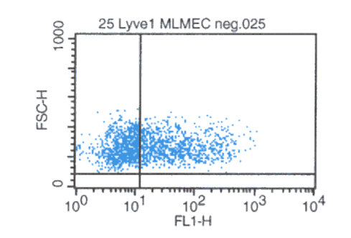
ReliaTech GmbH
Rabbit anti-mouse LYVE-1
(Cat #103-PA50AG)
Fig. 1: FACS analysis with primary mouse lung microvascular endothelial cells (MLMEC).
http://www.reliatech.de / orders@reliatech.de

